Slide 1

Data-driven Portfolio Optimizer
Team litquitity: Milad Nazar, Cindy kang, David gayman, Jonathan feldmann, and ibrahima diallo

Slide 2
Table of Contents
Section 1: Introduction to Asset Allocation
Section 2: Company Valuation & Price Analysis
Section 3: Portfolio Generator
Section 4: Systems & User Interface Integration
Section 5: Strategy Evaluation
Section 6: Portfolio Optimization
Section 7: Conclusion

Slide 3

Characteristics of Equity
Standard & Poor’s Classifies stocks into 11 sectors:
Consumer Discretionary
Consumer Staples
Energy
Financials
Health Care
Industrials
Information Technology
Materials
Telecommunication Services
Utilities
Real Estate Investment Trust
Notes:
Cindy: In order to achieve the optimal portfolio, we looked all the different industries and their unique characteristics. These 10 sectors can be further categorized into 2 types of stocks.

Slide 4



Types of Stocks
Cyclical (Value)
Non-Cyclical (Growth)
A cyclical stock is a stock that has a strong correlation with the movement of the general economy; it will appreciate quickly when economic growth is strong and fall rapidly when growth is slowing.
Automobile stocks are a good example of a cyclical stock; as economic growth slows, consumers have less disposable income to spend on new cars.
Non-cyclical securities are also called defensive stocks. They are stocks of companies that provide essential goods or services that we demand regardless of the business cycle.
Typically experience profit regardless of economic conditions.
Notes:
Cindy: At a fundamental level, there are two types of stocks, cyclical and non-cyclical. The classic example of a non-cyclical stock is a food and household products stock (P&G) as consumers and businesses need food and cleaning supplies regardless of the direction of the economy. However, when the economy is growing, non-cyclical stocks tend to lag behind cyclical stocks as they have a low correlation with the business cycle. There isn’t a one size fits all in terms of stock valuation methods. Depending on the industry and the type of stocks, certain metrics will be more meaningful for evaluating one company and not as useful for another. than others and vice versa.

Slide 5
Valuation Methods
Income and Asset-based approach
Balance sheet
Liquidation value
Dividend discount model
Earning value approach
Discounted future earning
Discounted cash flow valuation
Market value approach
Capitalization of earnings business valuation
Multiple of earning business valuation
Price-to-earnings (P/E), price-to-cashflow (P/CF)
Notes:
Jonathan

Slide 6
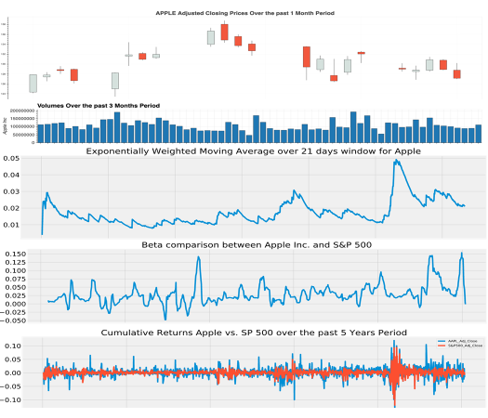
Price Analysis
Annualized Return
Beta
Exponential Moving Average (EMA)
Moving Average (MA)
Moving Average Deviation
Relative Strength Index
MACD
Momentum
Sharpe Ratio
Volume
Notes:
Step 1: Price History Analysis and Cumulative Returns
Explain data extraction

Slide 7
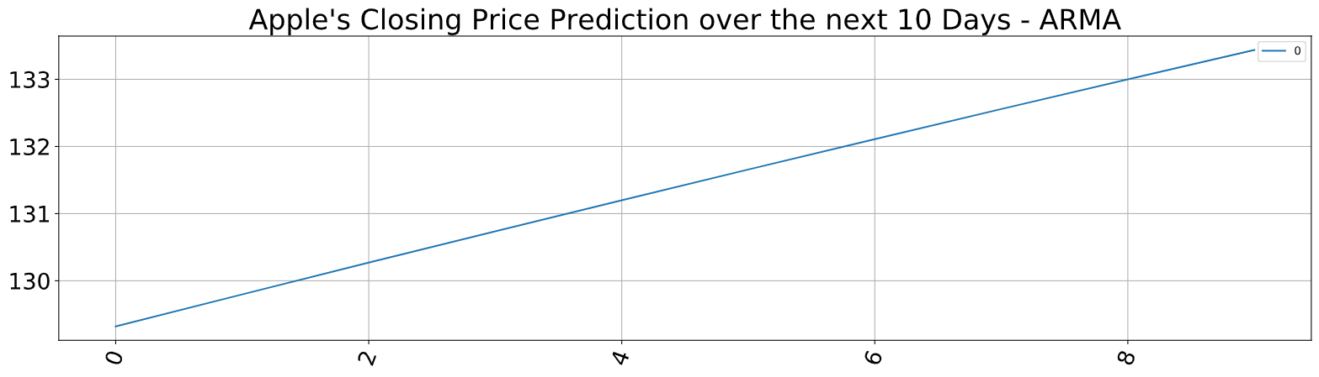
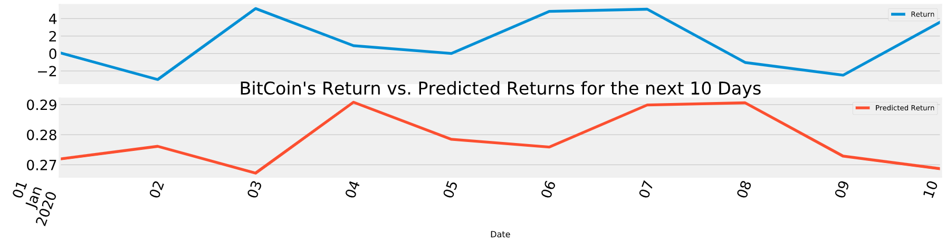
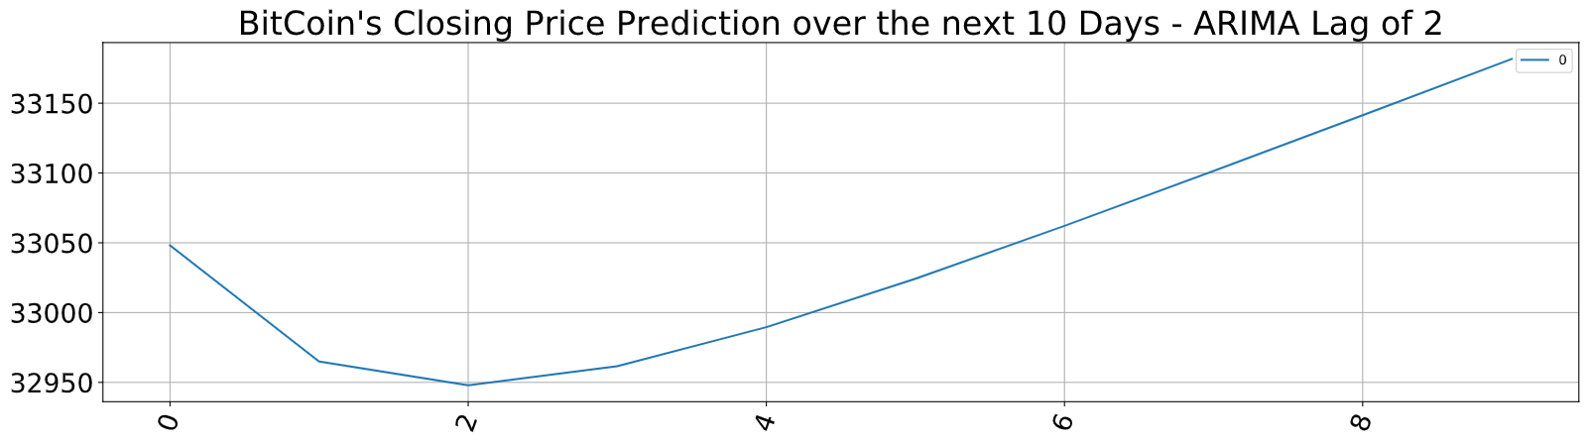
Price Forecast
his program uses an artificial recurrent neural network called Long Short Term Memory (LSTM) using the past 60 days stock price of (Apple Inc)
Tools:
Monte Carlo Simulation
ARMA Model
ARIMA Model
Garch
Linear Regression Method
Machine Learning
Long Short Term Memory
(LSTM)
Believe in your Models:
Stationarized your Data
Check your Model Summary for Alpha > 0.05
Add Sentiment Analysis as a Cherry on Top
Linear Regression Model
Notes:
Step 1: Price History Analysis and Cumulative Returns
Explain data extraction

Slide 8
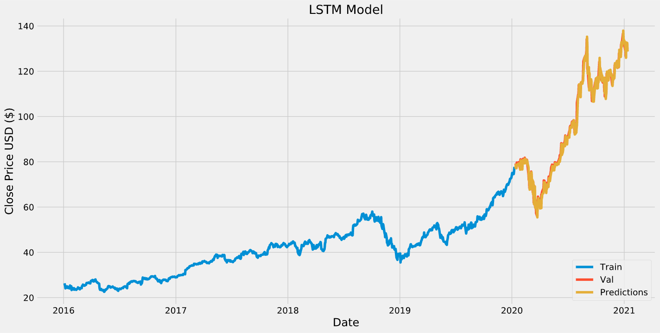
Price Forecast
Artificial Recurrent Neural Network (ARNN):
This model uses an artificial recurrent neural network called Long Short Term Memory (LSTM)
Important Information vs. Non-Important Information
Predict the closing stock price using the past 60 days stock price of (Apple Inc)
Key tools are the Epochs, and Batch Size
LSTM accepts a 3D set of data (938, 60, 1)
Date | Actual Price | Prediction
2021-01-06 | $126.59 | $132.02
2021-01-07 | $130.91 | $125.96
2021-01-08 | $132.05 | $132.71
2021-01-09 | $128.97 | $132.48
2021-01-10 | $128.80 | $128.74
Notes:
Step 1: Price History Analysis and Cumulative Returns
Explain data extraction

Slide 9
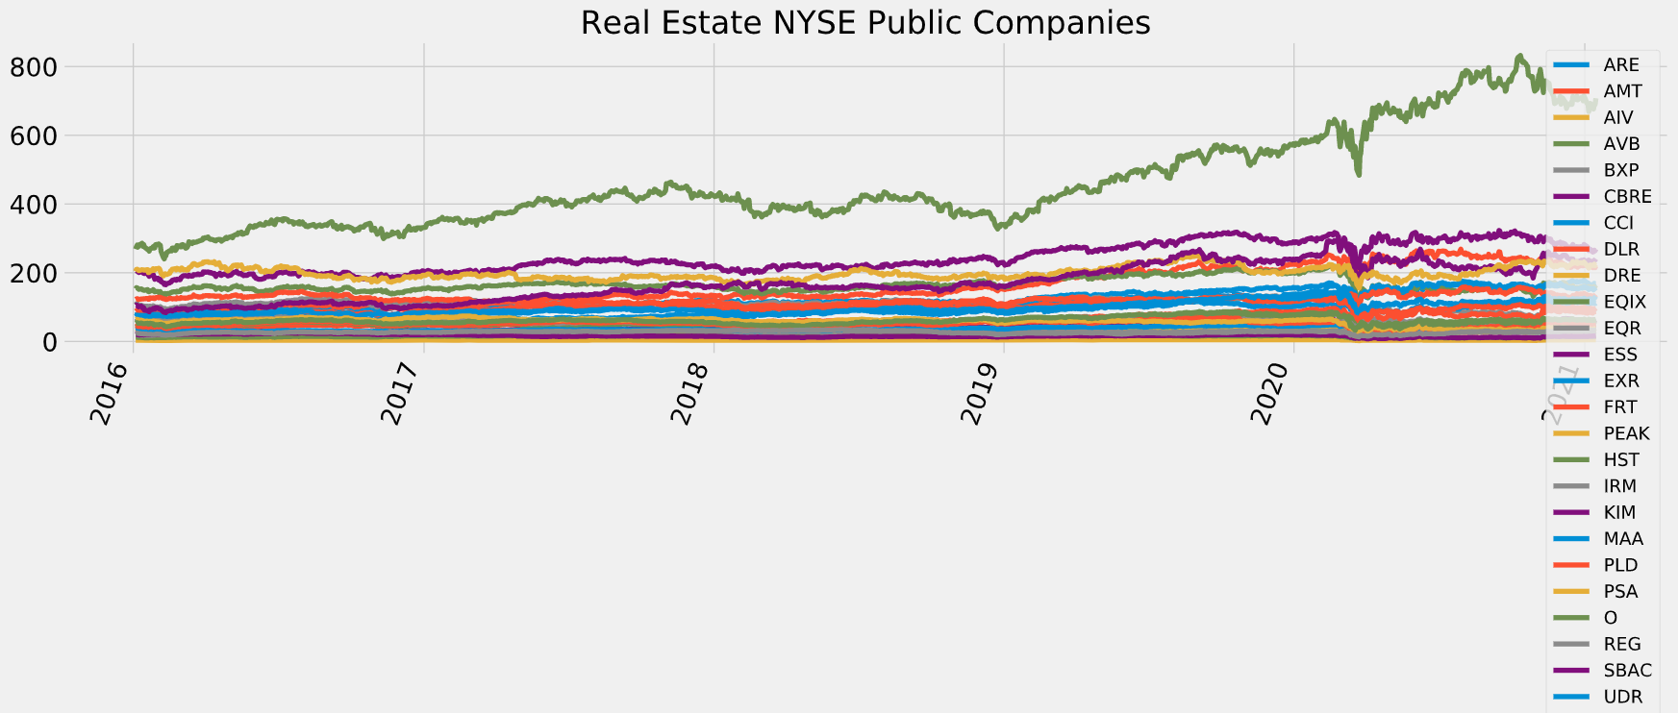
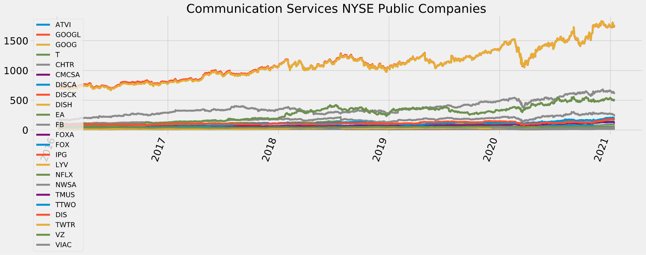
Portfolio Generator
his program uses an artificial recurrent neural network called Long Short Term Memory (LSTM) using the past 60 days stock price of (Apple Inc)
NYSE Stocks:
Getting Historical Data
Using API Keys
Categorizing NYSE Stocks into various Industry
Analyze Each Industry Separately
Fin the best Stocks out of Each Industry
Build a Portfolio based on Annual Return, Annual Volatility, Sharpe Ratio, and other Technical Factors
An example is on the next Page
Notes:
Step 1: Price History Analysis and Cumulative Returns
Explain data extraction

Slide 10
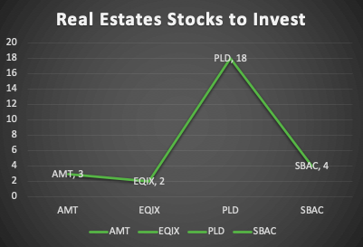
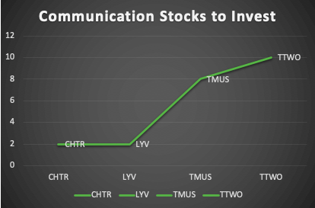
Portfolio Generator
his program uses an artificial recurrent neural network called Long Short Term Memory (LSTM) using the past 60 days stock price of (Apple Inc)
Real Estate Industry | Communication Industry
Expected Annual Return: 21% | Expected Annual Return: 33.8%
Annual Volatility: 23.4% | Annual Volatility: 24.1%
Sharpe Ratio: 0.82 | Sharpe Ratio: 1.32
Tools:
Efficient Frontier
Risk Models
Expected Returns
Sentiment Analysis
Your $5,000 Portfolio
Left Over: $90.17
Left Over: $120.02
Notes:
Step 1: Price History Analysis and Cumulative Returns
Explain data extraction

Slide 11
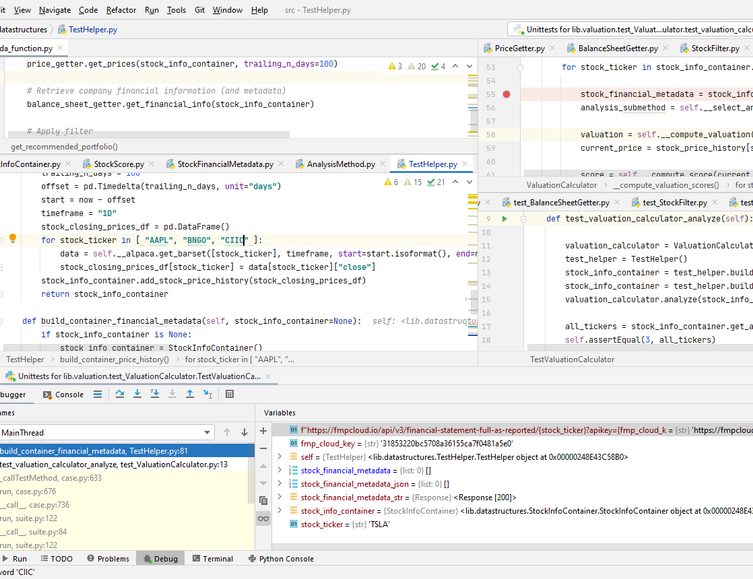
Processing System
Software Architecture
Testing and investigations in Jupyter Lab notebooks.
Functionalized code into Python modules.
Utilized object-oriented design principles.
Validation
Lambda code validated with offline unit tests.
Notes:
abstraction, encapsulation, inheritance, and polymorphism

Slide 12
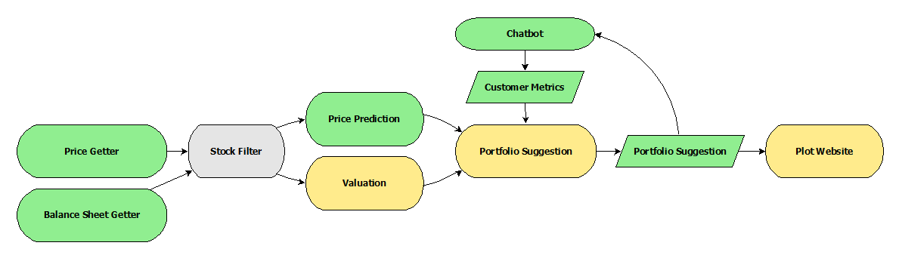
System Description
Stock evaluation and portfolio building techniques coded into modular data processing system.
Execution initiated by Amazon Lex chatbot.
Financial data retrieved from web API’s.
Core analysis consists of:
Price Prediction
Company Valuation
Portfolio suggestion utilizes multiple analysis results.
Plots and data insights displayed in dashboard.

Slide 13
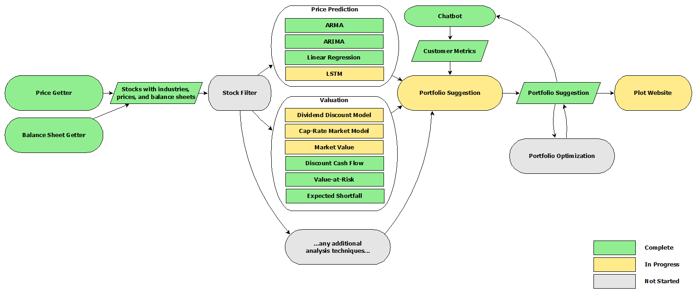
Full System

Slide 14
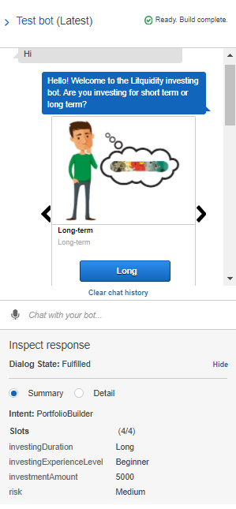
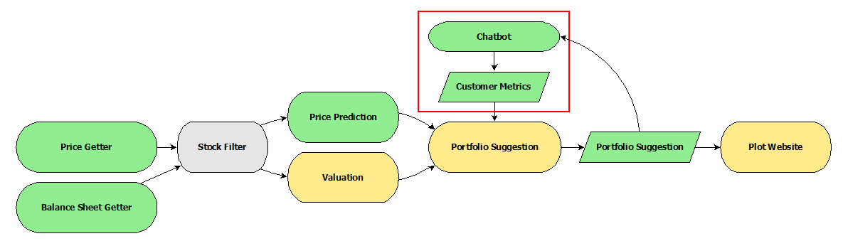
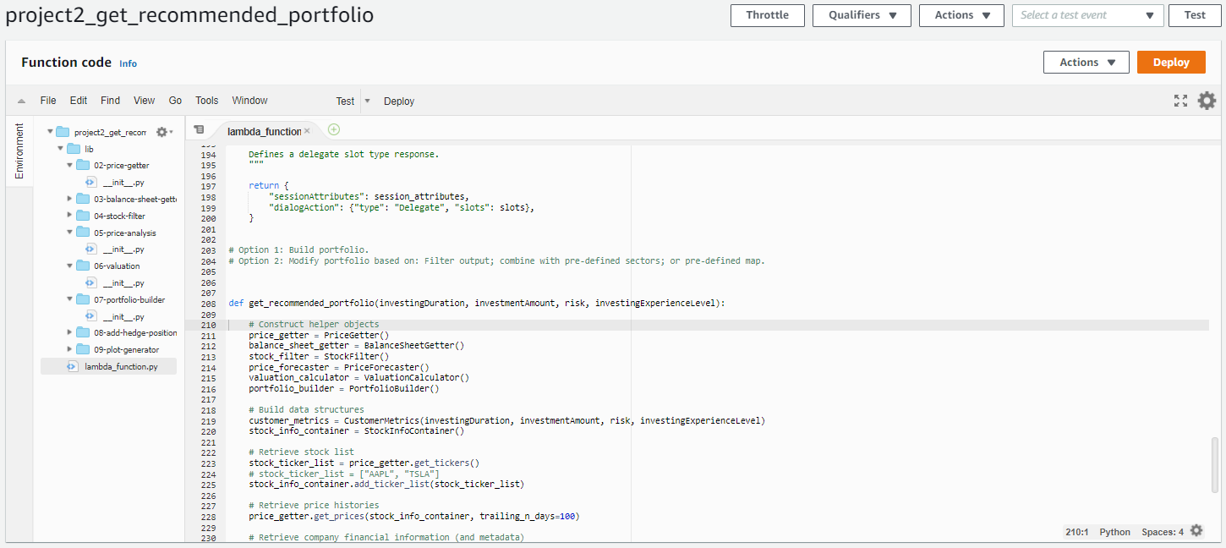
System Component: Chatbot
Customer Preferences
Customer investing preferences are retrieved through a chat bot hosted on Amazon Lex.
Preferences include:
Investing duration
Investing experience level
Investing amount
Risk tolerance
Data Processing
Chat bot launches full stock data analysis solution in Amazon Lambda.

Slide 15
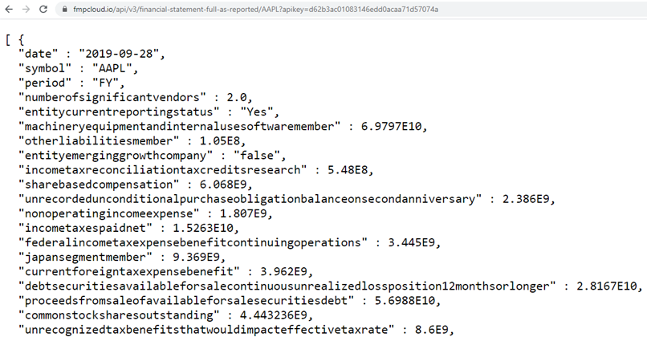
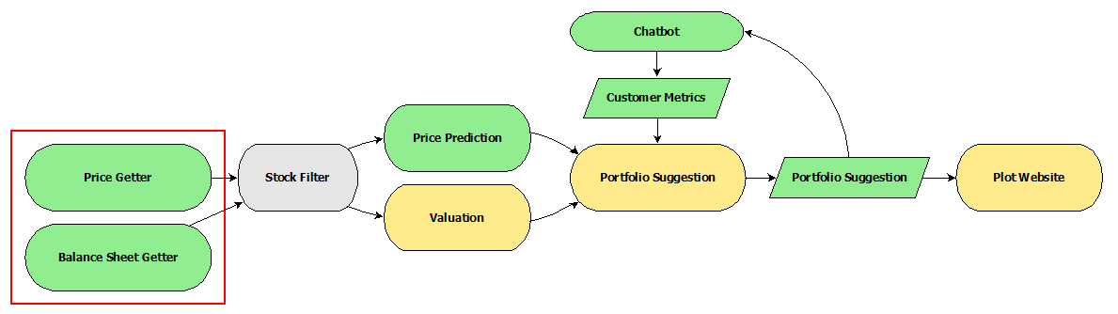
System Component: Data Retrieval
External API’s
Fmp Cloud Financial Statements API: https://fmpcloud.io/documentation#financialStatementsAsReportedOnSEC
Alpaca Trade API: https://alpaca.markets/docs/api-documentation/api-v2/
Alpaca Trade API Python Wrapper: https://github.com/alpacahq/alpaca-trade-api-python
Cloud Computing Framework
Amazon Web Services – Lex: https://aws.amazon.com/lex/
Amazon Web Services – Lambda: https://aws.amazon.com/lambda/

Slide 16
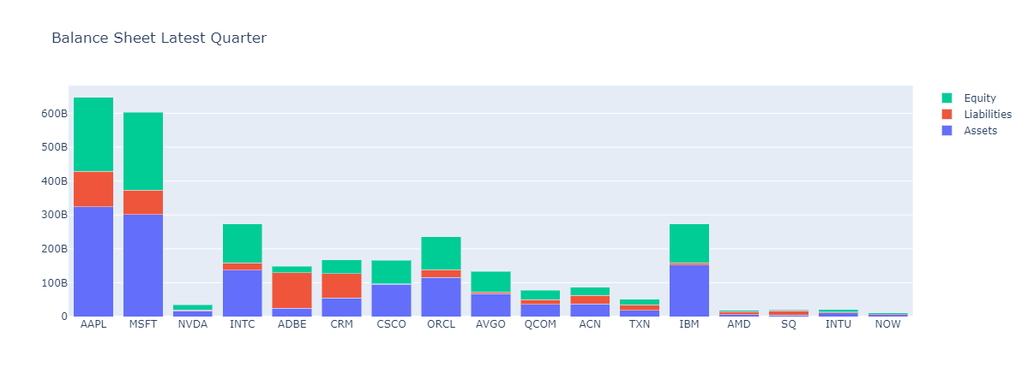
Balance Sheet Analysis
Notes:
Ibrahima – valuation with a focus on the technology sector

Slide 17
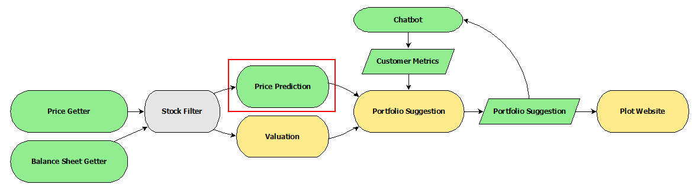
System Component: Price Prediction
Prediction Techniques
ARMA
ARIMA
Linear Regression
LSTM

Slide 18
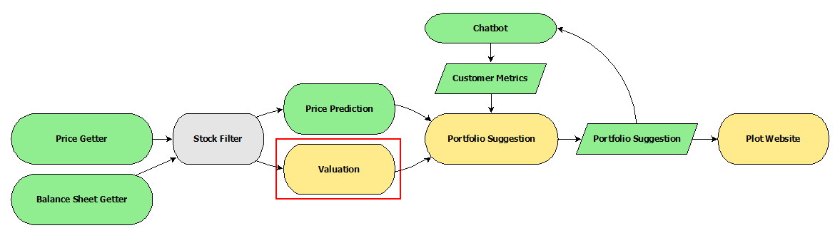
System Component: Valuation
Condition | Valuation Method
Stock has nonzero dividend | Dividend Discount Model
Industry internally flagged for DCF preference | Discount Cash Flow
Industry flagged for cap-rate | Cap-Rate Market Model
No other conditions met | Market Value

Slide 19
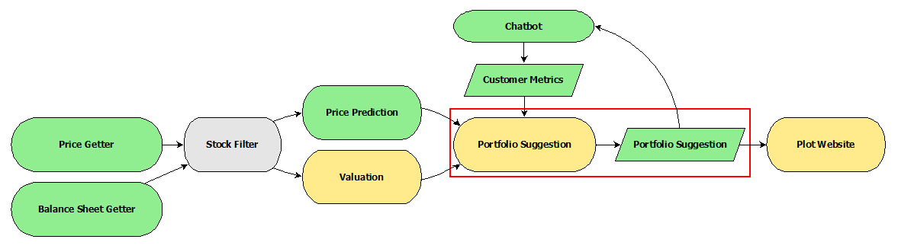
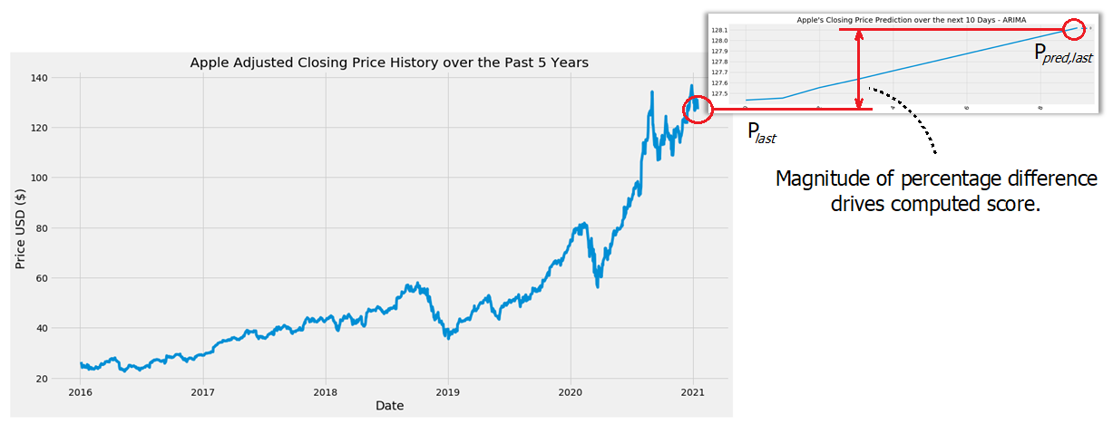
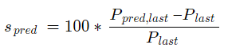
System Component: Portfolio Suggestion
Score Calculation
Score value generated for each analysis result.
Composite score computed as weighted sum.
Stocks with highest composite scores are selected for portfolio.

Slide 20
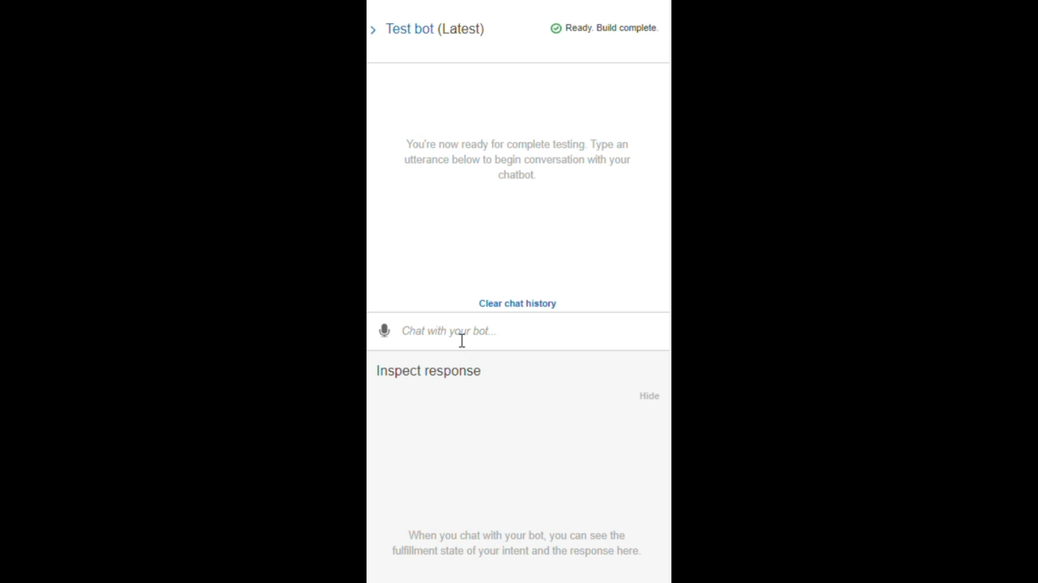

Slide 21

Thanks so much!
Questions?

